Slide 1
Imaging Blood Brain Barrier Dysfunction in Drug Resistance Epilepsy: A Multi-Center Feasibility Study
Nir Cafri
Health sciences graduate student

Slide 2
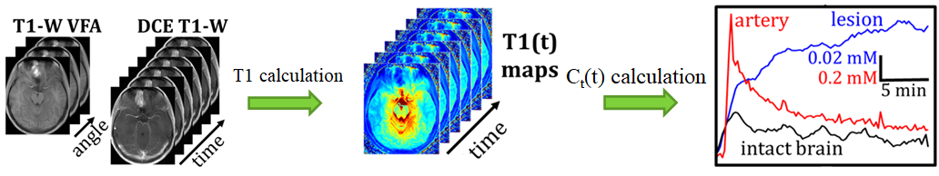
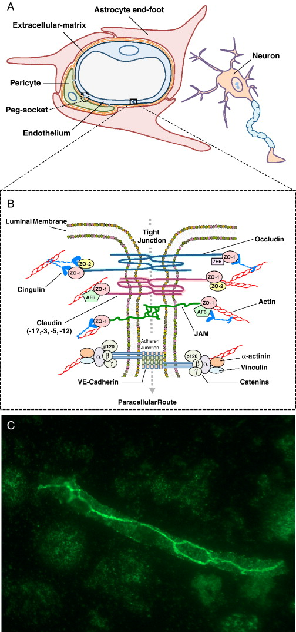
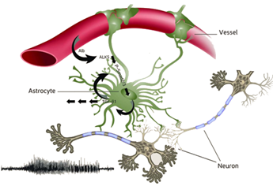
Dynamic contrast enhanced MRI
Notes:
https://www.sciencedirect.com/science/article/pii/S0969996108001927

Slide 3
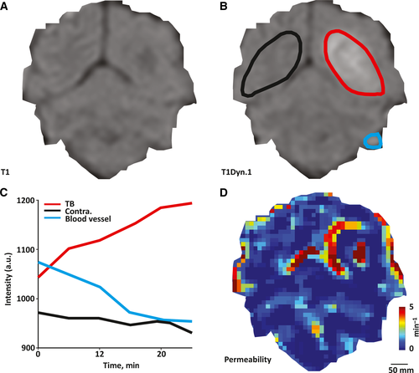
Permeability calculation methods
Linear
Notes:
https://conorbrennan91.wordpress.com/2014/11/10/critical-review-of-blood-brain-barrier-article/

Slide 4
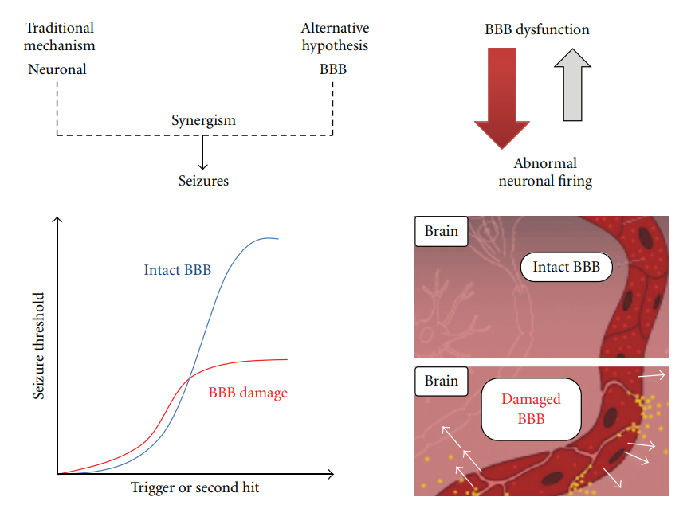
Biological mechanism

Slide 5
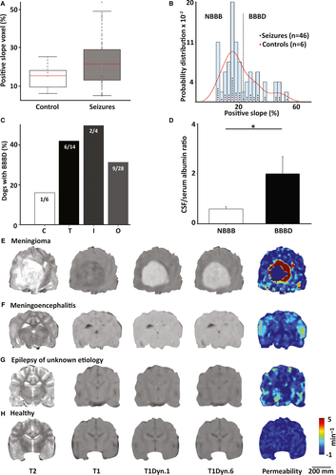
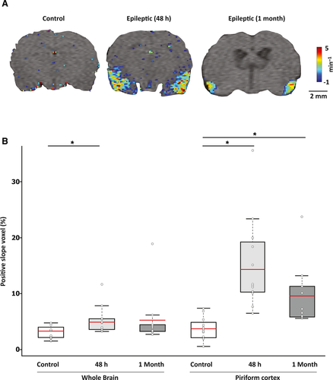
Previous studies

Slide 6
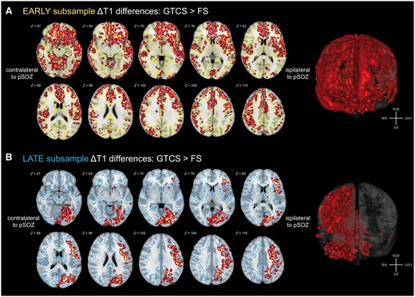
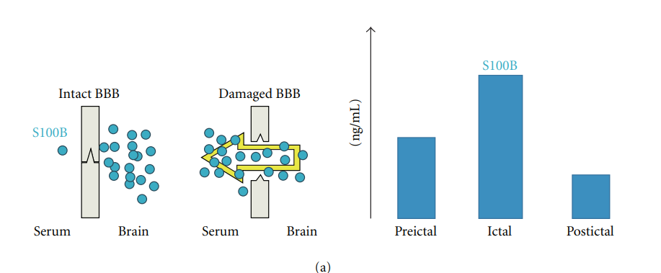
Previous studies

Slide 7
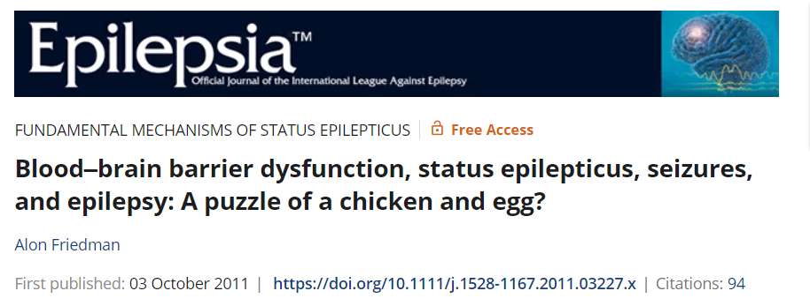
Goal
Show the BBBD disparities between patients with epilepsy and healthy controls
Define these distinctions and propose the degree of penetrability within specific regions.
Outline the defining traits of epilepsy subcategories, focal, generalized, and focal subgroups within the temporal and frontal regions.

Slide 8
Epilepsy
Controls
Focal
Generalized
Frontal
Temporal

Slide 9
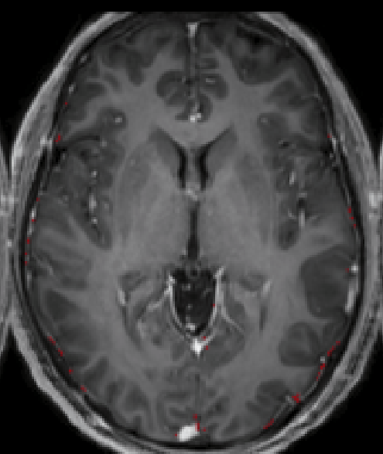
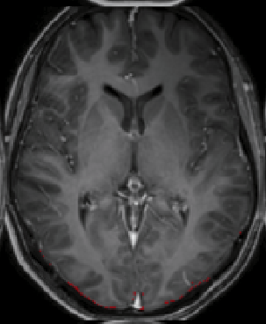
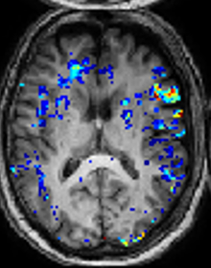
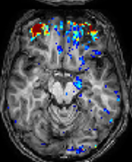
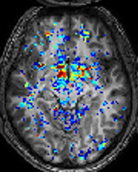
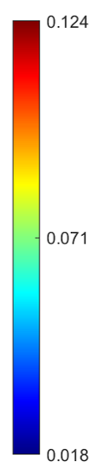


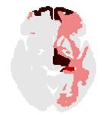

Epilepsy vs controls
Controls N=28
Epilepsy N=40
1 2
1 2 3
D
F

Slide 10
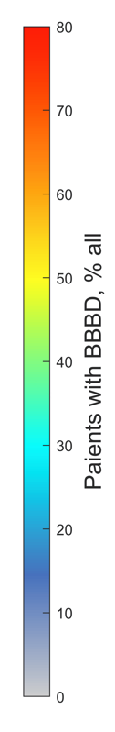
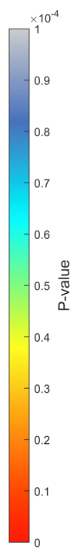
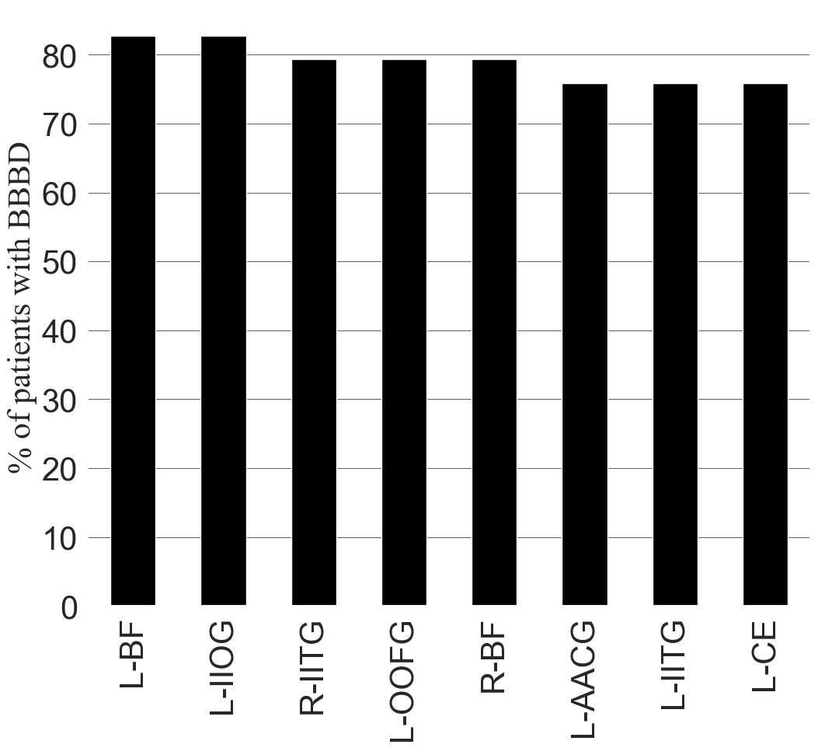
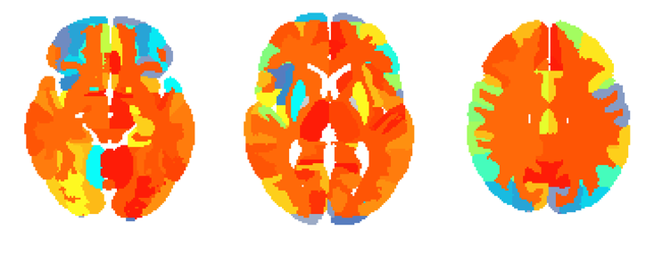
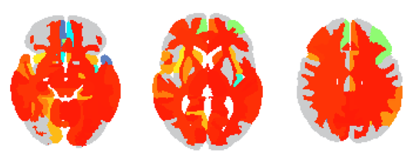
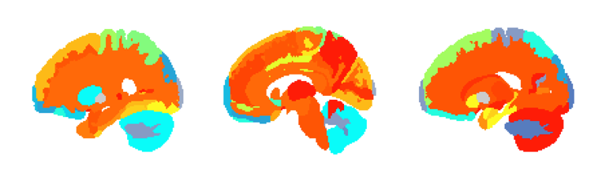
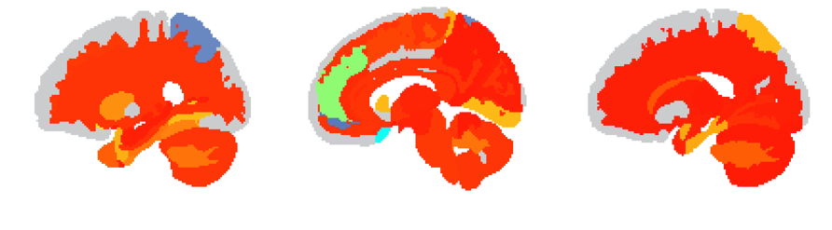
Regional analysis
% of patients
P value
Statistics
Notes:
Regions legend; L-AACG: Left ACgG anterior cingulate gyrus, L-BF: Left Basal Forebrain, L-CE: Left Cerebellum Exterior, L-IIOG: Left IOG inferior occipital gyrus, L-IITG: Left ITG inferior temporal gyrus, L-MPGMS: Left MPrG precentral gyrus medial segment, L-MMTG: Left MTG middle temporal gyrus, L-OOFG: Left OFuG occipital fusiform gyrus, R-BF: Right Basal Forebrain, R-FFG: Right FuG fusiform gyrus, R-H: Right Hippocampus, R-IITG: Right ITG inferior temporal gyrus, R-OOPOTIFG: Right OrIFG orbital part of the inferior frontal gyrus
and this to figure 3:
Regions legend; CVLI: Cerebellar Vermal Lobules I-V, L-AACG: Left ACgG anterior cingulate gyrus, L-EEA: Left Ent entorhinal area, L-IIOG: Left IOG inferior occipital gyrus, L-IITG: Left ITG inferior temporal gyrus, L-OOFG: Left OFuG occipital fusiform gyrus, L-VD: Left Ventral DC, R-A: Right Amygdala, R-CE: Right Cerebellum Exterior, R-IIOG: Right IOG inferior occipital gyrus, R-PPCG: Right PCgG posterior cingulate gyrus, R-PPOG: Right POrG posterior orbital

Slide 11
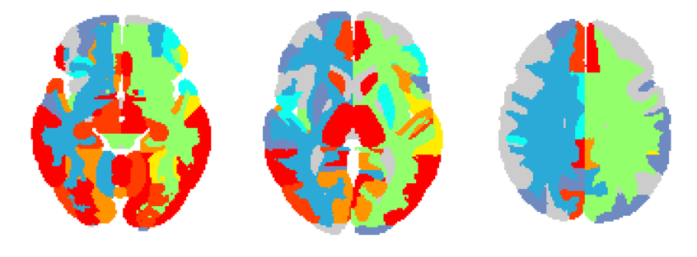

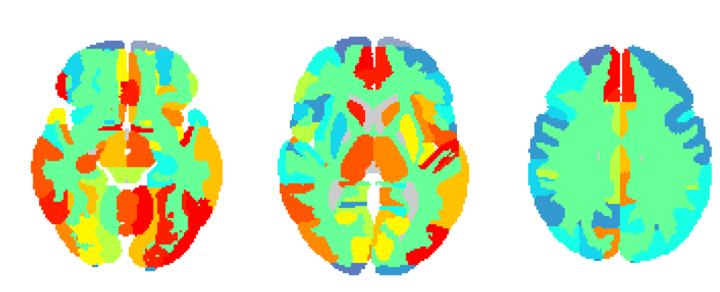
Focal vs Generalized
Generalized. N=10
Statistics
Focal. N=30
Patients with BBBD, % all

Slide 12
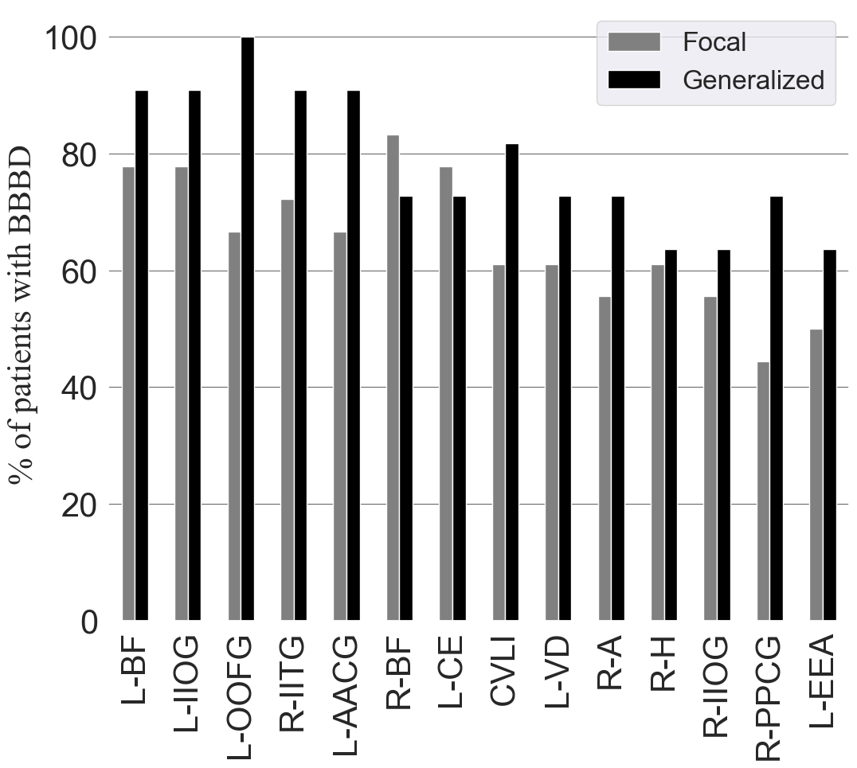
Focal vs Generalized
Notes:
Regions legend; L-AACG: Left ACgG anterior cingulate gyrus, L-BF: Left Basal Forebrain, L-CE: Left Cerebellum Exterior, L-IIOG: Left IOG inferior occipital gyrus, L-IITG: Left ITG inferior temporal gyrus, L-MPGMS: Left MPrG precentral gyrus medial segment, L-MMTG: Left MTG middle temporal gyrus, L-OOFG: Left OFuG occipital fusiform gyrus, R-BF: Right Basal Forebrain, R-FFG: Right FuG fusiform gyrus, R-H: Right Hippocampus, R-IITG: Right ITG inferior temporal gyrus, R-OOPOTIFG: Right OrIFG orbital part of the inferior frontal gyrus
and this to figure 3:
Regions legend; CVLI: Cerebellar Vermal Lobules I-V, L-AACG: Left ACgG anterior cingulate gyrus, L-EEA: Left Ent entorhinal area, L-IIOG: Left IOG inferior occipital gyrus, L-IITG: Left ITG inferior temporal gyrus, L-OOFG: Left OFuG occipital fusiform gyrus, L-VD: Left Ventral DC, R-A: Right Amygdala, R-CE: Right Cerebellum Exterior, R-IIOG: Right IOG inferior occipital gyrus, R-PPCG: Right PCgG posterior cingulate gyrus, R-PPOG: Right POrG posterior orbital

Slide 13
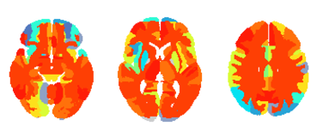
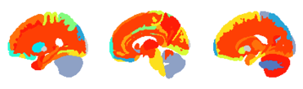
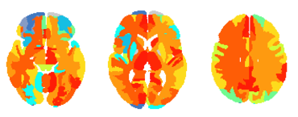
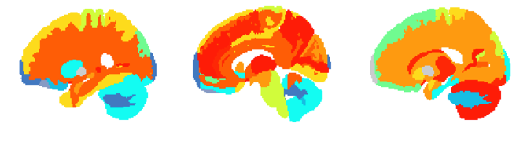
Frontal epilepsy
Frontal N=15
Statistics
Temporal N=13

Slide 14
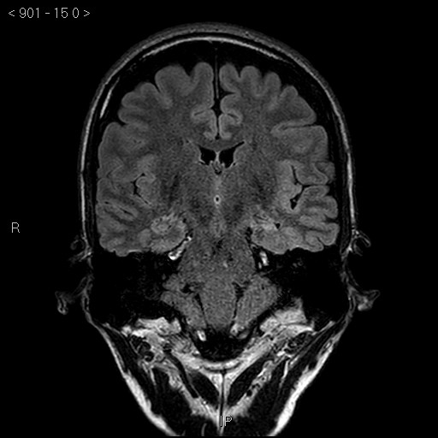
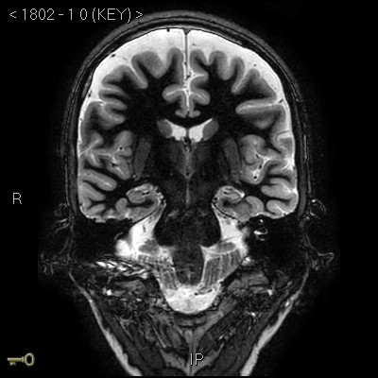
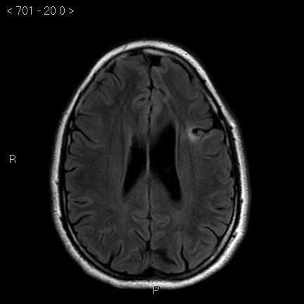
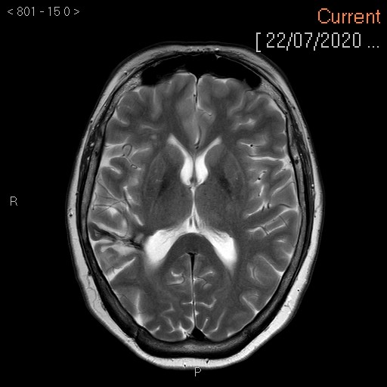
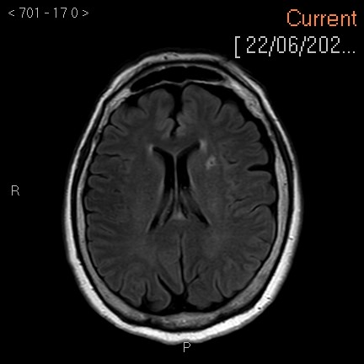

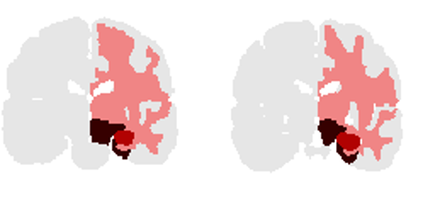

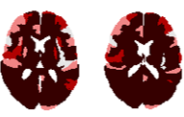


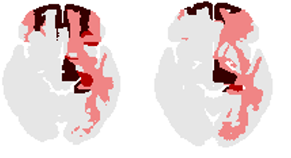
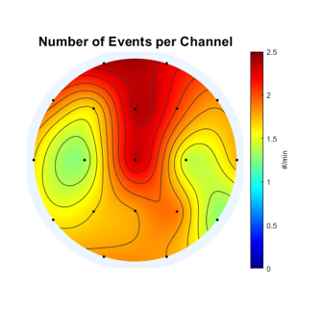
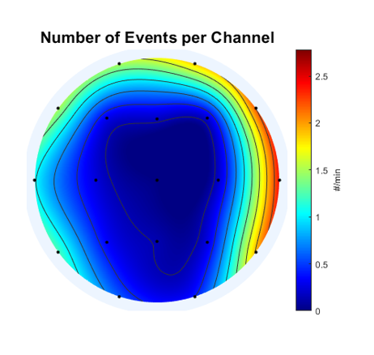
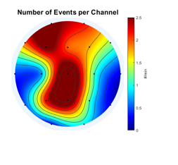
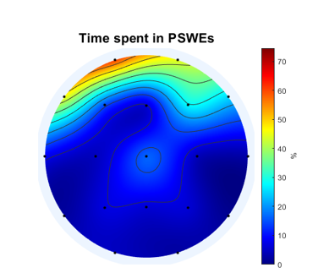
Lesion vs BBBD
A Left Hippocampal Sclerosis: 35 yo man, focal epilepsy with impaired awareness, secondary generalization
B Frontal lode epilepsy: 33yo man, EEG: normal
C Frontal lobe Epilepsy: 55yo woman, EEG: frontal temporal right
D M/P Cortical Dysplasia: 57yo woman, EEG: Left fronto-temporal

Slide 15
Conclusions
Epilepsy is associated with an elevated occurrence of BBBD
High correlation was found between clinical diagnosis and BBBD localization in patients with temporal lobe epilepsy.
BBBD imaging is a promising diagnostic biomarker for the localization of epilepsy
Role of the BBB in evolution

Slide 16
Future research
Finish the paper!
Cross analysis with SBM, EEG source imaging, ai lesion detection
Incorporate EEG for all patients
Increase sample size for focal and generalized (Theodor Rüber Department of Epileptology, University of Bonn Medical Center, Bonn, Germany)

Slide 17
Temporal epilepsy
B
A

Slide 18
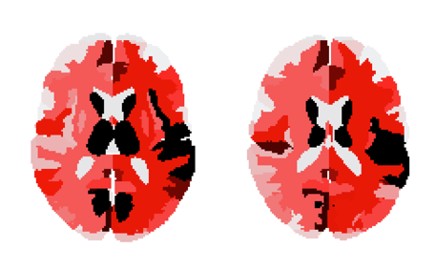
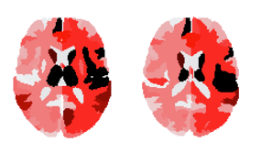
TA_4648
EA_0804

Slide 19
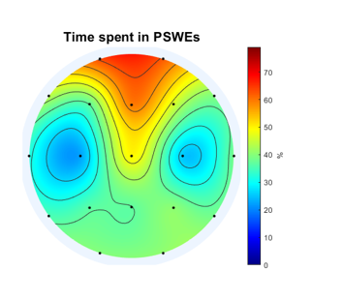
MH_4108
BT_3007
TA_4648
EA_0804

Slide 20
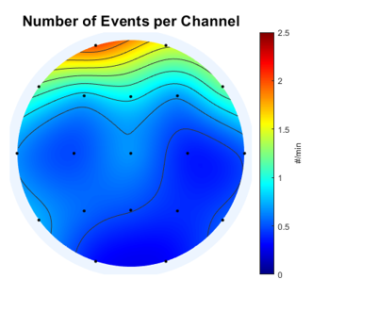
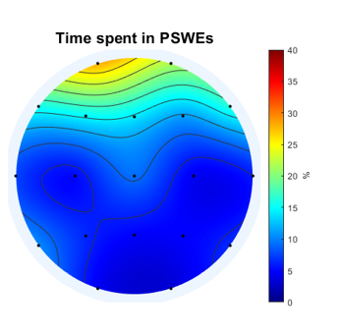
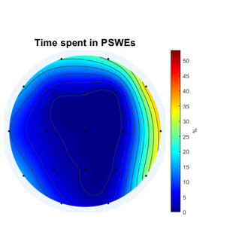
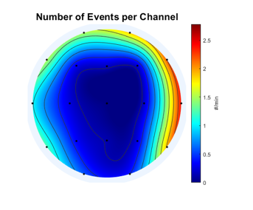
FIGURE 5: PSWE and BBBD
ME 4933
TA 4648

